Slide 1
Kick-off Meeting
PDK008
Davide Giovanetti - July 2023

Slide 2
Welcome
Hello everyone,
Thank you for joining us today. I am Davide Giovanetti, and I'm excited to welcome you to this kick-off meeting. We are here to embark on an important project together, and your presence and contribution are highly valued. Let's work together to achieve success.
let's get started!

Slide 3
Agenda
Client
Objectives
Time schedule
Team structure and Roles
WBS
Risks and issues
The masterplan and the milestones
EVA

Slide 4
Client: Company A

Slide 5
Objectives:
BAP002
Training Sessions
Manuals

Slide 6
Objectives: BAP002 /1
The main objective is the production and installation of machinery included with a compressor at Company A's premises, with the provision of spare parts kit for one-year warranty period.
BAP002 Capabilities:
Feed bottles one by one from a pallet to the packaging equipment
Move the bottles to the packaging station
Pack the bottles in cardboard box: the number of bottles per box shall be selected from a fixed and predetermined options list
Send the box to the palletizing machine (not included in the delivery)

Slide 7
Objectives: BAP002 /2
Features
The BAP002 system is designed to handle bottles of different sizes, including 200ml, 750ml, and 1000ml. This versatile system exhibits excellent performance capabilities in terms of speed, as outlined below:
200ml bottles: Processing capacity of 1000 bottles per hour.
750ml bottles: Workload capacity of 600 bottles per hour.
1000ml bottles: Efficient handling of 400 bottles per hour.

Slide 8
Objectives: Training Sessions
We will design the training sessions to cater to the specific needs of different roles within Company A. The training program will be customized as follows:
Role | Number of participants | Training duration
Operators | Up to 10 | 5 hours
Supervisors | Up to 3 | 12 hours (2 days)
Maintenance Technicians | Up to 4 | 24 hours (4 days)

Slide 9
Objectives: Manuals
The manuals accompanying the BAP002 model equipment serve as invaluable resources for users.
Key Features of the Manuals:
Step-by-step instructions for equipment operation
Detailed maintenance procedures
Troubleshooting guidelines
Clear and accurate information
User-friendly format
Comprehensive guidance on:
Equipment Operation
Maintenance Procedures
Troubleshooting
Safety Precautions

Slide 10
Q&A?

Slide 11
Time Schedule
From the sign of the contract, we stipulated this deadlines
1. Delivery on site: 12 months
2. End of installation: 14 months
3. Acceptance: 15 months
4. End of Warranty: 27 months

Slide 12
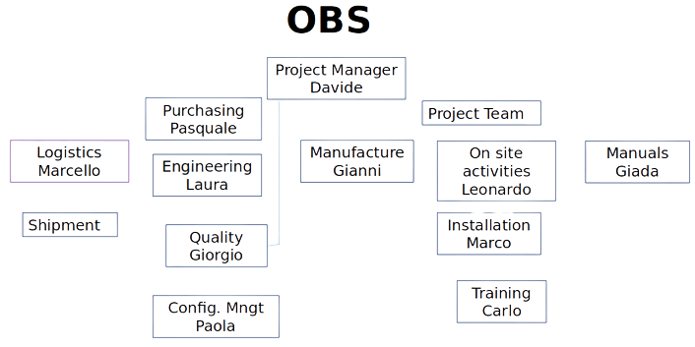
Team Structure and Roles

Slide 13
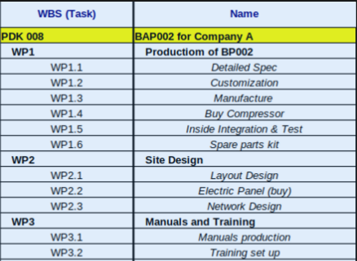
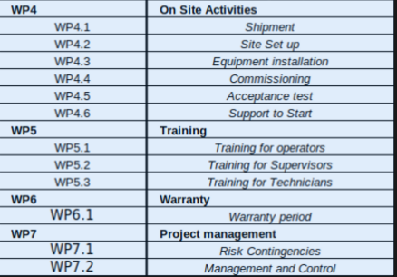
Work Breakdown Structure

Slide 14
Q&A?

Slide 15
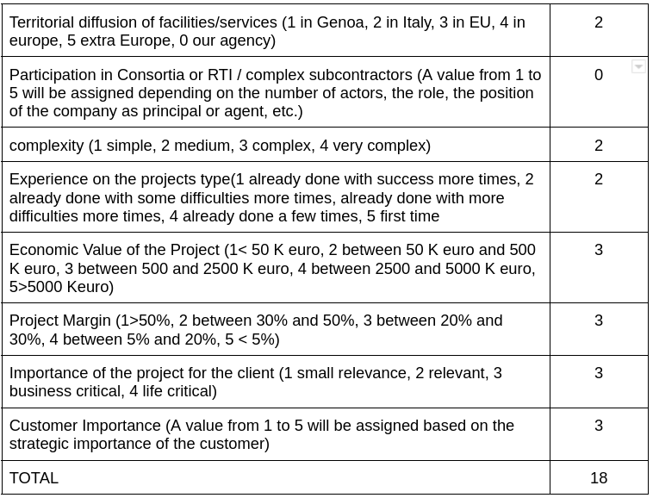
Risk and Issues

Slide 16
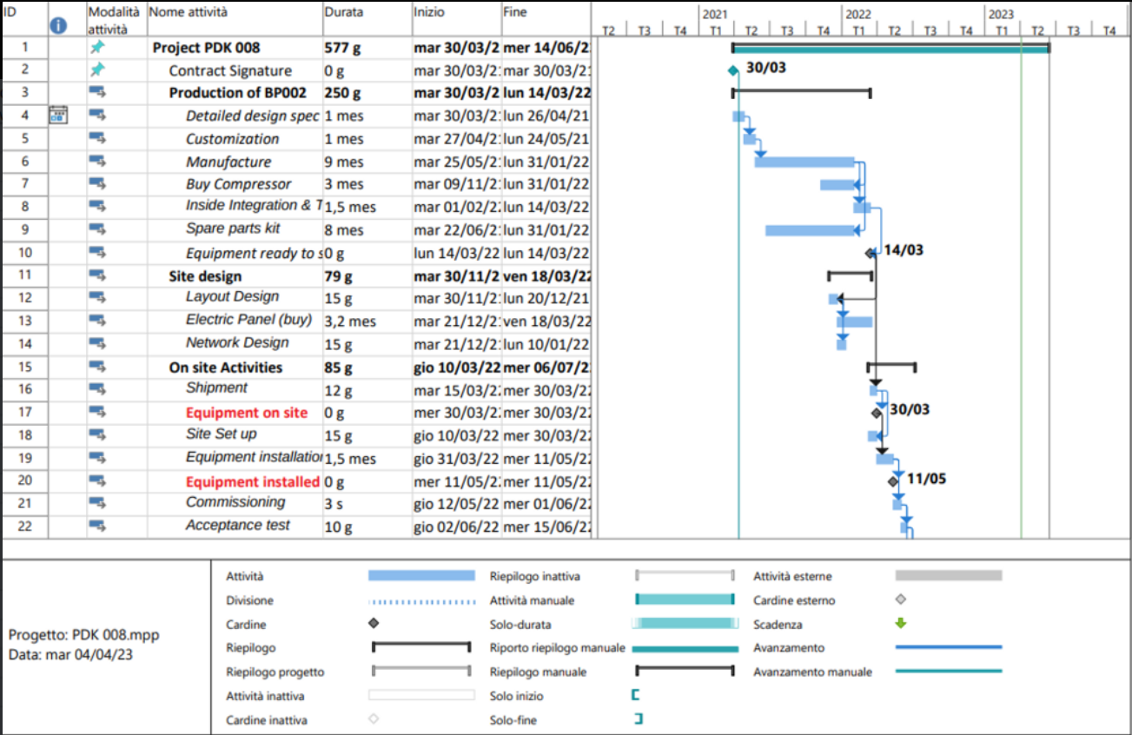
Master Plan: GANTT chart /1

Slide 17
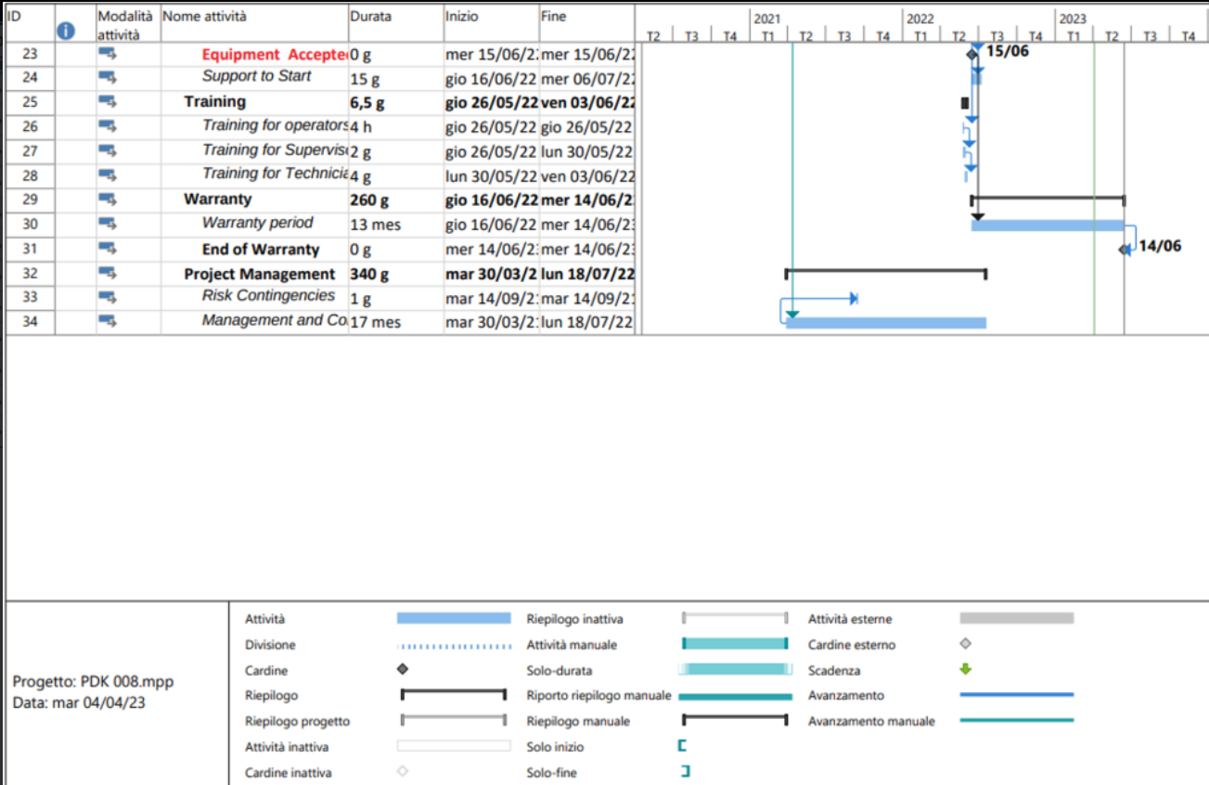
Master Plan: GANTT chart /2

Slide 18
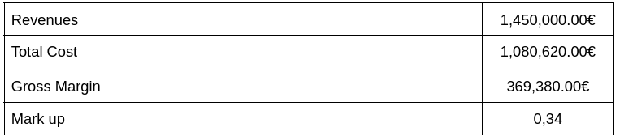
EVA: Economic Value Added

Slide 19
Q&A?

Slide 20
Thank you for your attention.
Davide Giovanetti

